Slide 1

Personalized IdleView App Development
Team 7 - Midterm Presentation 1

Slide 2
Presentation Content
- Background and Objectives
- Overall System Structure (Diagram)
- Requirements Analysis and Definition (Use Case Diagram, Use Case Specification)
- Progress and Technology Stack
- Issues and Solutions
- Future Schedule

Slide 3
Project Background
- Company Collaboration: Collaboration with LG Electronics, focusing on software development for webOS.
- Platform Focus: Create a personalized IdleView app/widget for webOS devices.
- Need for Development:
- Idle screens does not return anything during device is in idle mode.
- Need for a solution that offers real-time and meaningful information while also reducing power consumption.

Slide 4
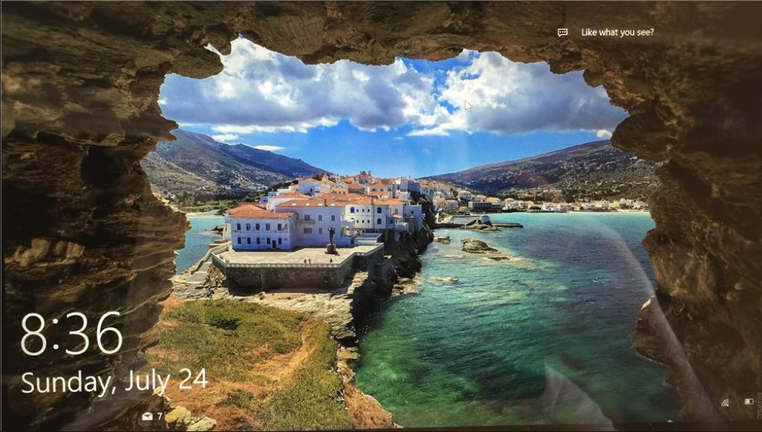
Notes:
An idle view is what you see on a screen when nothing is actively happening, like a home screen right here.
A widget is a small tool on a screen that lets you interact with the app or see quick information, like a time widget showing right here.

Slide 5

Project Objective
- Main Goal: Develop a personalized IdleView app that displays custom content during the device’s idle state while minimizing power consumption.
Notes:
// We will use a Raspberry Pi and a monitor to run this application in the end.

Slide 6
Project Objectives: Key Features
- User Authentication: Implement a login system for personalized settings.
- Widget Customization: Allow users to configure the IdleView screen (weather, media, calendar).
- Real-Time Data Updates: Integrate live weather, calendar events, media playback.
- Power Efficiency: Ensure low-power mode operation while displaying critical information.

Slide 7
Project Objectives: Technical Objectives
- Front-End Development: Build a responsive UI using Enact. Typescript, Vite → fast build times.
- Back-End Development: Set up API infrastructure using Node.js and Express.
- Database Integration: Use Prisma ORM to manage user data and widget configurations in MySQL.

Slide 8
Progress and Technology Stack
Frontend:
- Runtime Environment: Node.js
- Language: TypeScript
- Bundler: Vite
- Framework: Enact (React-based)
- Key Libraries: React-Router-Dom (Routing), Styled-Components (Styling), Axios (API Communication)
Backend:
- Runtime Environment: Node.js
- Language: TypeScript
- Framework: Express
- Key Libraries: Prisma (ORM for MySQL Database Connection)

Slide 9
Requirements Analysis and Definition
Use Case Diagram and Specifications:
- Login: System retrieves user idle view settings.
- Customize Widgets: Users can select widgets to display during idle.
Notes:
We’ve created both a class diagram and a detailed use case diagram to show the interactions users will have with the system.
The following diagrams and specifications provide a detailed view of these interactions.

Slide 10
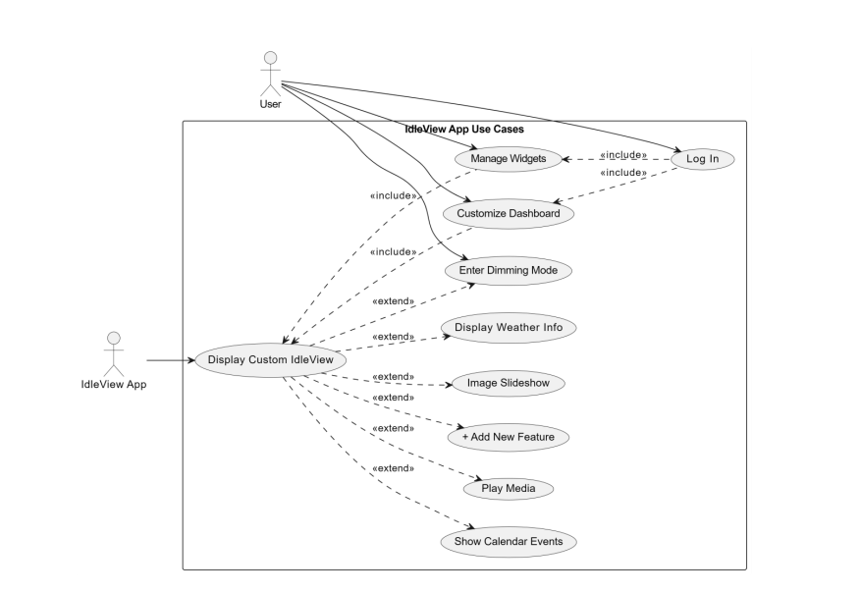

Slide 11
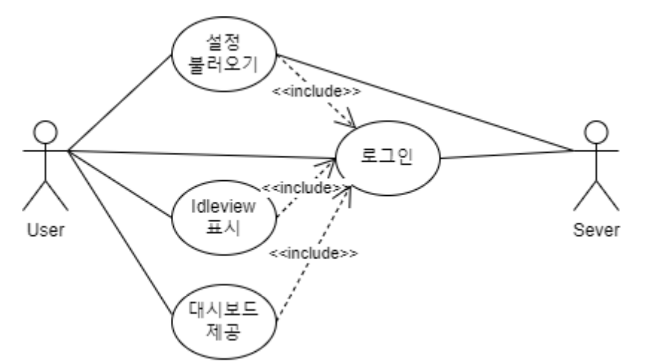

Slide 12
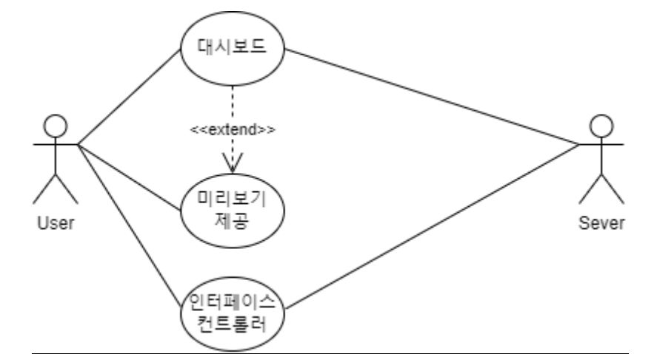

Slide 13
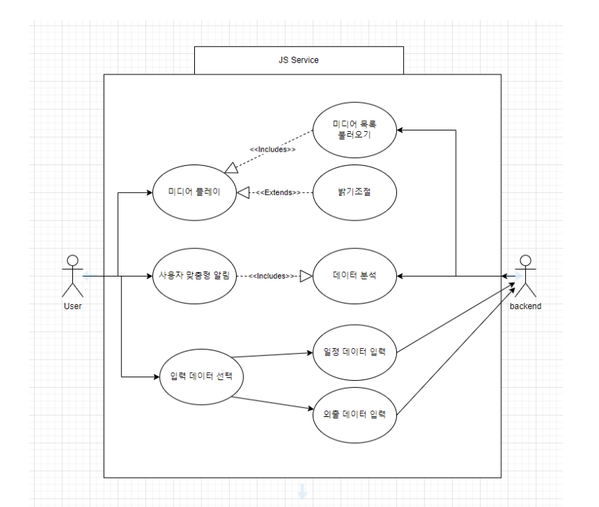

Slide 14
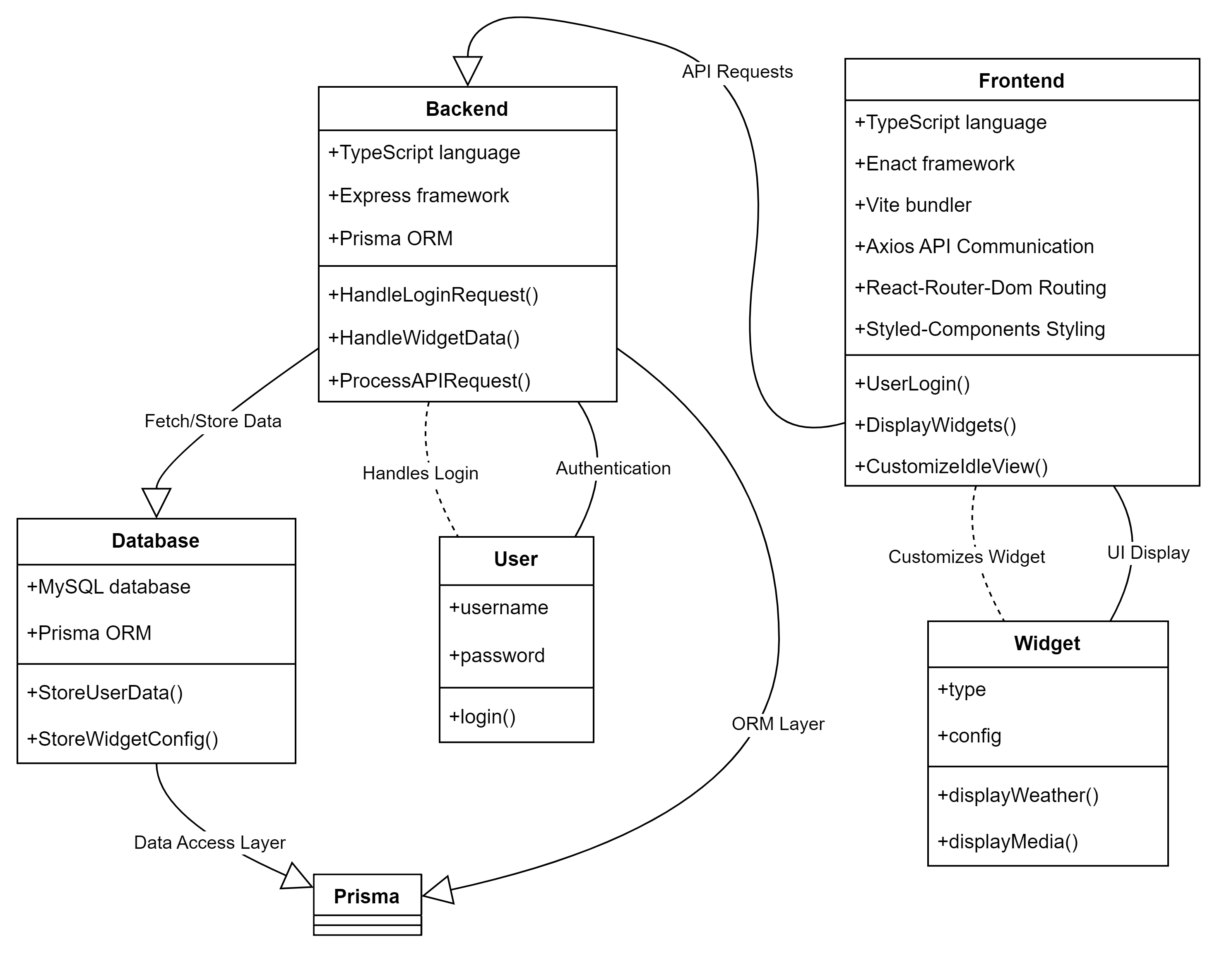

Slide 15
Issues and Resolutions
Issue 1: Difficulty downloading the webOS platform on our computers.
- Resolution: Exploring alternative systems and troubleshooting installation issues.
Issue 2: Communication barriers due to limited Korean language proficiency.
- Resolution: Shifting all communications to written formats to minimize misunderstandings.

Slide 16
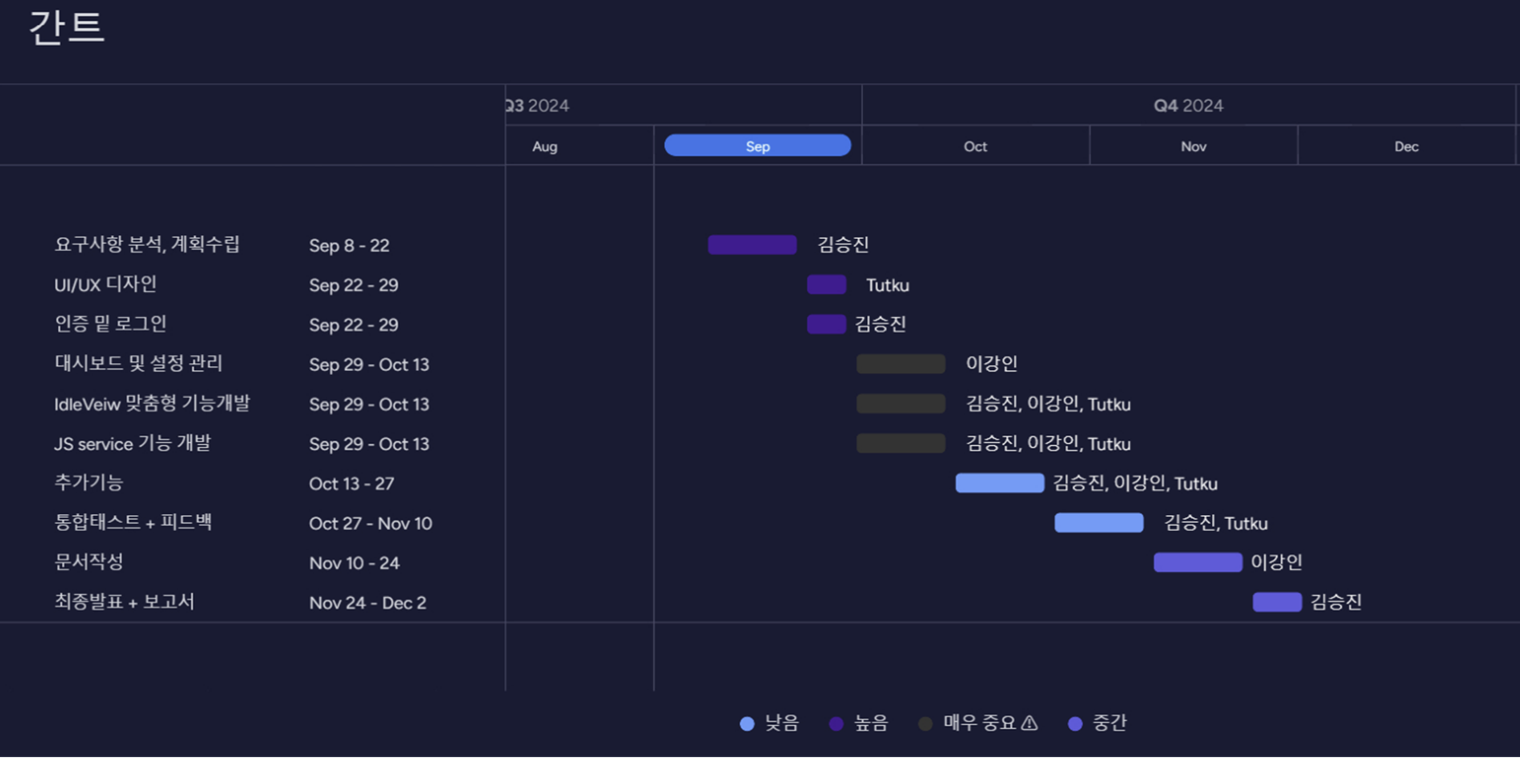

Slide 17
Future Schedule
29 Sep. – 13 Oct.
Dashboard Development & IdleView Customization
13–27 Oct.
Develop Additional Features.
27 Oct. – 10 Nov.
Integration Tests &
Gathering Feedbacks
10–24 Nov.
Write Documentation.
24 Nov. – 2 Dec.
Final Presentation and Report Submission.

Slide 18
Thank You!
Notes:
This concludes our presentation.

